Slide 1


Data Visualization
Turning Data into Insights
Dated: 14 June 2025
Instructor : Fawad Bahadur

Slide 2

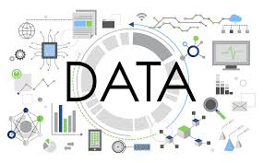


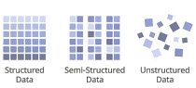
Introduction to Data
What is Data?
Data is raw facts and figures collected for analysis and decision-making.
Types of Data:
1. Structured Data
Organized in rows and columns
Example: Excel sheets, SQL databases
2. Unstructured Data
No predefined format
Example: Images, videos, emails, social media posts
3. Semi-structured Data
Partially organized
Example: JSON, XML files
Instructor : Fawad Bahadur

Slide 3
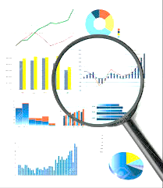
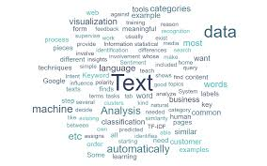
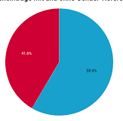

Conti…
Common Data Format | Example
Text | Tweets, Documents
Numerical | Sales Figures, Temperature
Categorical | Gender, Country
Time Series | Stock Prices over time
Multimedia | Photo, Audio Recordings
Instructor : Fawad Bahadur

Slide 4





Where Does Data Come From?
3. Sensors and IoT Devices
Smart devices
Wearables
Environmental sensors
1. Internal Sources
Company databases
Transaction records
CRM systems
Employee feedback
4. Surveys and Questionnaires
Customer feedback
Market research
2. External Sources
Social media platforms (Facebook, Twitter)
Public datasets (government, research organizations)
Web scraping
Third-party data providers
5. Multimedia Sources
Images, videos, audio recordings
Satellite imagery

Slide 5





Why is Data Important?
Informed Decision-Making
Supports business, healthcare, education & policy decisions
Enables data
Driven strategies
2. Improved Efficiency
Identifies patterns to optimize processes
Reduces cost & time through automation
3. Personalization
Powers recommendation systems (e.g., Netflix, Amazon)
Enhances user experience
4. Innovation & Growth
Drives AI, machine learning, and product development
Enables predictive analytics
5. Competitive Advantage
Companies leveraging data outperform competitors
Helps in trend prediction and market insights

Slide 6
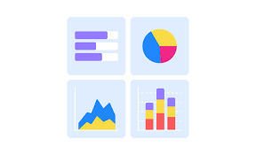
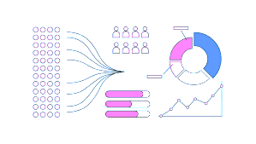
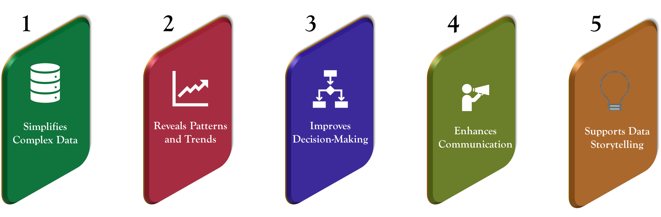
Data Visualization and Its Importance
What is Data Visualization?
The graphical representation of information and data using charts, graphs, maps, and dashboards.
Data Visualization Important

Slide 7

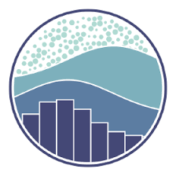



Common Data Visualization Tools
1. Matplotlib (Python)
Basic plotting library
Highly customizable
Great for line, bar, scatter plots
4. Tableau
Drag-and-drop visual analytics tool
Ideal for business dashboards and reports
2. Seaborn (Python)
Built on top of Matplotlib
Beautiful statistical plots
Works well with pandas DataFrames
5. Power BI
Microsoft’s BI platform
Integrates well with Excel and Azure
3. Plotly (Python/JS)
Interactive and web-ready plots
3D, animated and dashboard capabilities
6. Excel
Basic visualizations for quick analysis
Widely used in business settings

Slide 8
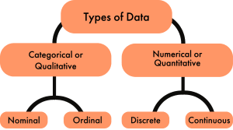
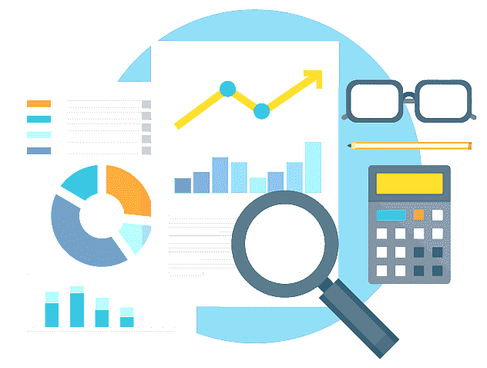
Quantitative vs Qualitative Data
Quantitative Data (Numerical Data)
Data that can be measured and expressed in numbers.
2. Qualitative Data (Categorical Data)
Describes characteristics or qualities; not numerical.
Types
Discrete Data: Countable values (e.g., number of students, cars)
Continuous Data: Measurable, can take any value within a range (e.g., height, weight, temperature)
Types
Nominal Data: Categories without order (e.g., gender, colors, countries)
Ordinal Data: Categories with a logical order (e.g., education level, satisfaction ratings)
Key Difference
Quantitative = "How much?" Qualitative = "What kind?"

Slide 9
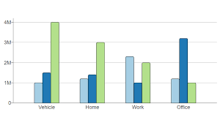
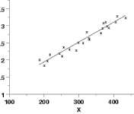
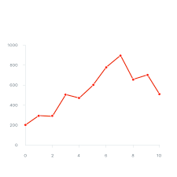
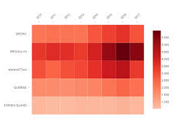
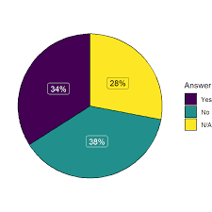
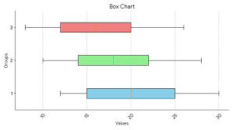
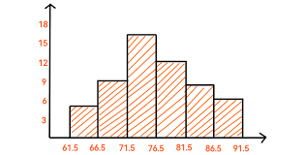
Types of Data Visualizations
1. Bar Chart
Compare values across categories
Example: Sales by region
5. Scatter Plot
Show relationships between two variables Example: Height vs. weight
2. Line Chart
Show trends over time
Example: Monthly temperature
6. Heatmap
Visualize correlations or intensity Example: Correlation matrix
3. Pie Chart
Show parts of a whole
Example: Market share by company
7. Box Plot
Summary of distribution (median, quartiles, outliers)
Example: Salary distribution
4. Histogram
Distribution of numeric data
Example: Exam score frequency

Slide 10

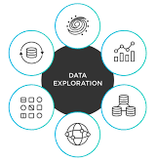

Introduction to Matplotlib
What is Matplotlib?
Matplotlib is a popular Python library used for creating static, animated, and interactive visualizations.
Installation
pip install matplotlib
conda install matplotlib
Key Features:
2D plotting library
Supports line, bar, scatter, pie, histogram, and more
Highly customizable (colors, labels, styles)
Works well with NumPy and pandas
Example
import matplotlib.pyplot as plt
x = [1, 2, 3, 4]
y = [10, 20, 25, 30]
plt.plot(x, y)
plt.title("Simple Line Plot")
plt.xlabel("X-axis")
plt.ylabel("Y-axis")
plt.show()
Use Cases:
Data exploration and reporting
Visual summaries in machine learning
Creating dashboards and reports

Slide 11
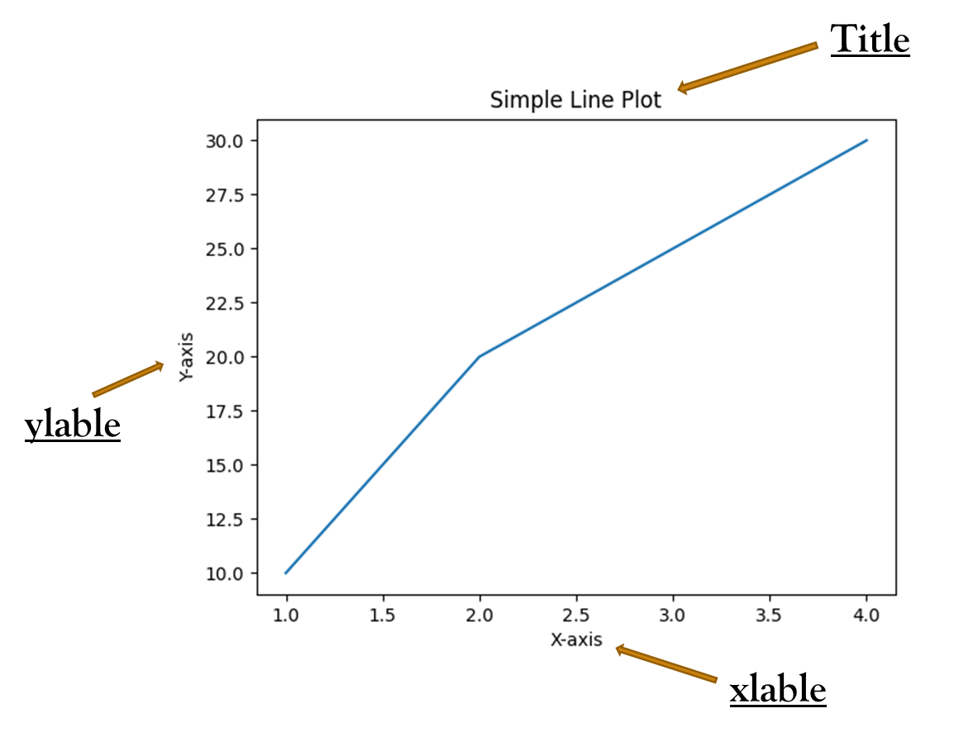
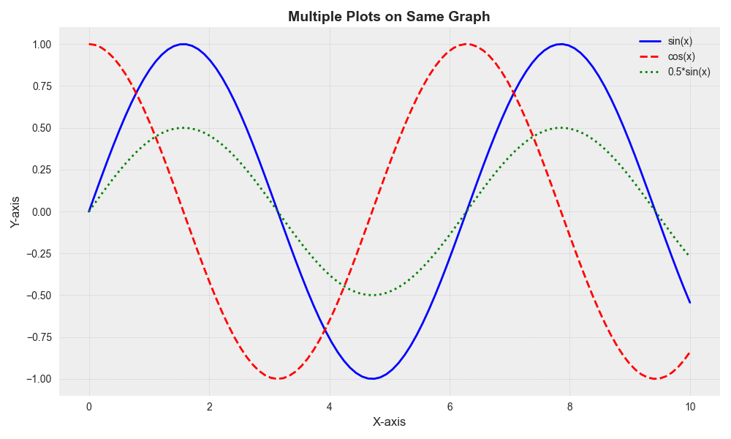
Creating a Simple Line Plot
Key Elements of a Plot
plt.plot() – Draws the line graph
plt.title() – Adds a title
plt.xlabel() / plt.ylabel() – Labels axes
plt.show() – Displays the plot
Code
Python
import matplotlib.pyplot as plt
x = [1, 2, 3, 4, 5]
y = [10, 20, 15, 25, 30]
plt.plot(x, y)
plt.title("Basic Line Plot")
plt.xlabel("X-axis")
plt.ylabel("Y-axis")
plt.show()
Tip
Matplotlib also supports multiple plots on the same graph using plt.plot() multiple times before plt.show().

Slide 12
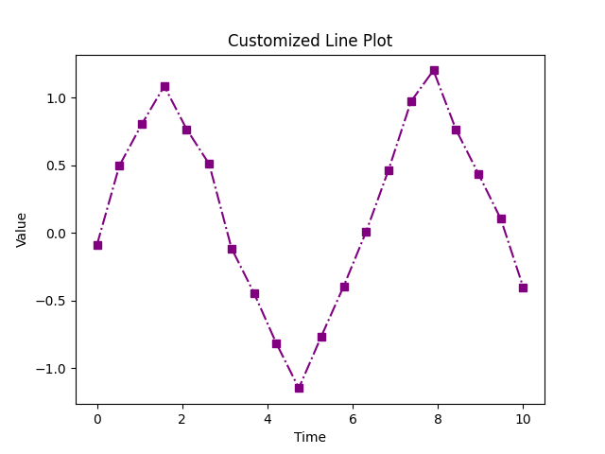
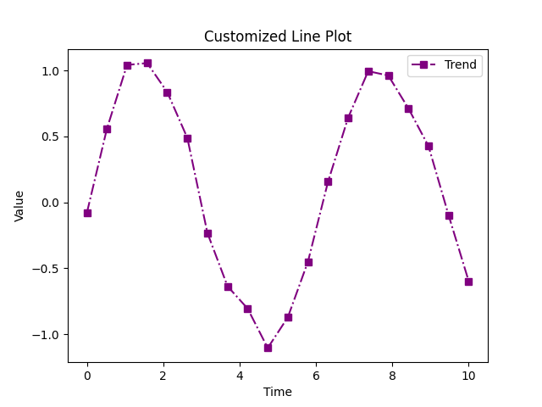
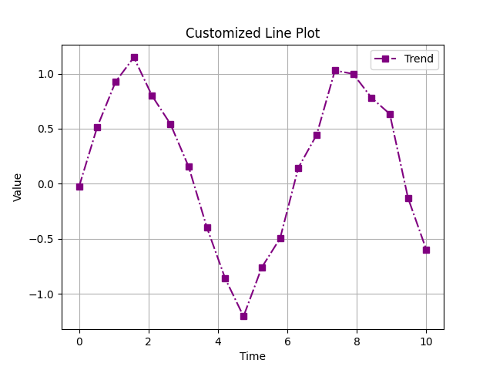
Customizing Plots in Matplotlib
Code
plt.plot(x, y, color='purple', linestyle='-.', marker='s’)
plt.title("Customized Line Plot")
plt.xlabel("Time")
plt.ylabel("Value")
plt.grid(True)
plt.legend(["Trend"])
plt.show()
1. Changing Colors, Line Styles & Markers
Python
plt.plot(x, y, color='green', linestyle='--', marker='o’)
color = 'red', 'blue', 'green', etc.
linestyle = '-', '--', '-.', ':’
marker = 'o' (circle), 's' (square), '*' (star), etc.
2. Adding Grid & Legend
Python
plt.grid(True)
plt.legend(["Sales"])
3. Adjusting Figure Size
Python
plt.figure(figsize=(8, 5))

Slide 13
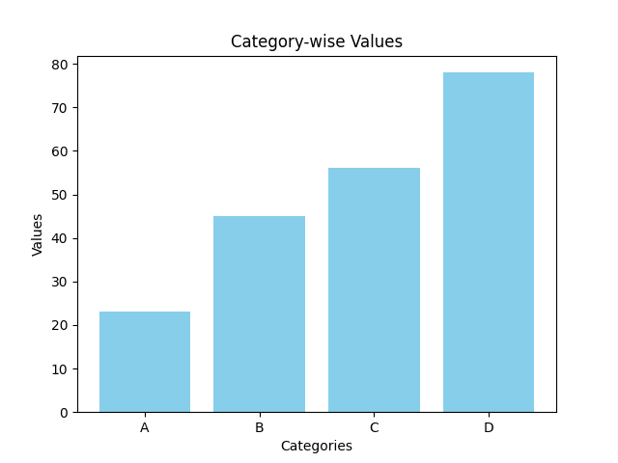
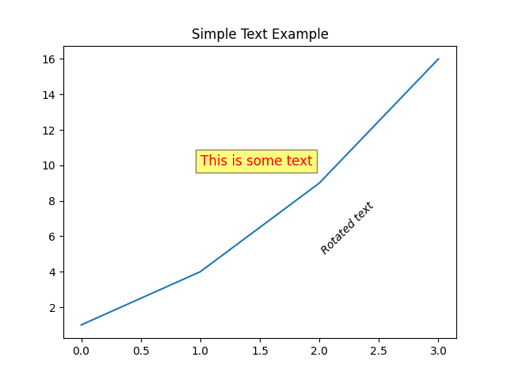
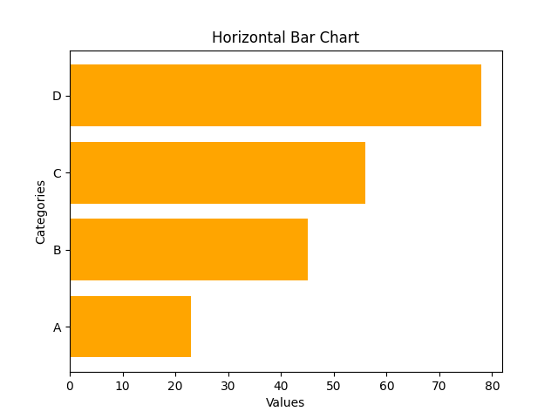
Creating Bar Charts in Matplotlib
1. Vertical Bar Chart
Python
import matplotlib.pyplot as plt
categories = ['A', 'B', 'C', 'D']values = [23, 45, 56, 78]
plt.bar(categories, values, color='skyblue’)
plt.title("Category-wise Values")
plt.xlabel("Categories")
plt.ylabel("Values")
plt.show()
3. Customization Options
Change bar color, width, and alignment
Add value labels using plt.text()
2. Horizontal Bar Chartpython
Python
plt.barh(categories, values, color='orange’)
plt.title("Horizontal Bar Chart")
plt.xlabel("Values")
plt.ylabel("Categories")
plt.show()
Use Case
Compare quantities across discrete categories (e.g., sales per product)

Slide 14
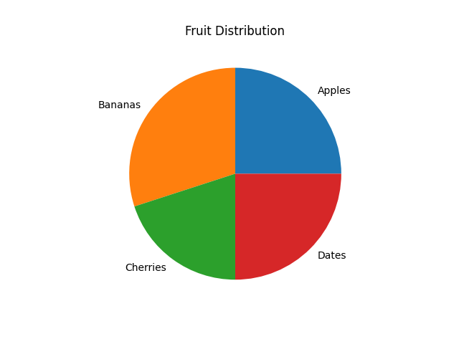
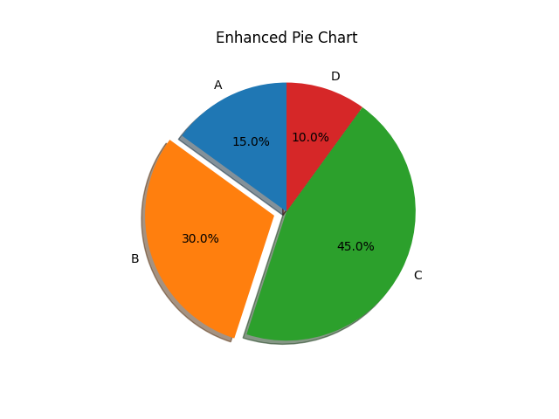
Creating Pie Charts in Matplotlib
Basic Pie Chart
Python
import matplotlib.pyplot as plt
labels = ['Apples', 'Bananas', 'Cherries', 'Dates’]
sizes = [25, 30, 20, 25]
plt.pie(sizes, labels=labels)
plt.title("Fruit Distribution")
plt.show()
2. Adding Customization
Python
plt.pie(
sizes,
labels=labels,
autopct='%1.1f%%', # Show percentages
startangle=90, # Start from top
explode=[0, 0.1, 0, 0], # Emphasize one slice shadow=True)
plt.title("Enhanced Pie Chart")
plt.show()
Use Cases
Represent part-to-whole relationships (percentages, shares)

Slide 15
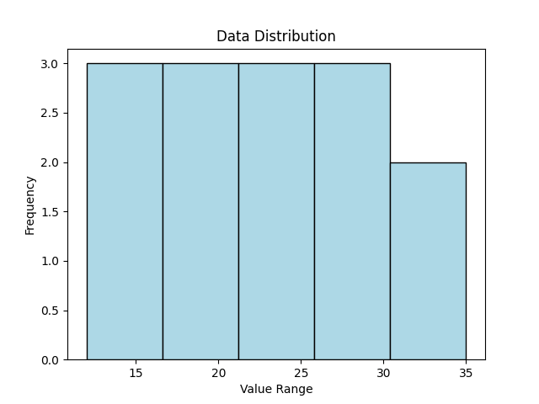
Creating Histograms in Matplotlib
1. What is a Histogram?
A histogram shows the distribution of a numeric variable by grouping data into bins.
3. Customization Options
bins: Number of intervals
color & edgecolor: Visual styling
Add grid, mean lines, etc. for clarity
2. Basic Histogram
Python
import matplotlib.pyplot as plt
data = [12, 15, 13, 18, 19, 21, 22, 23, 25, 26, 28, 30, 32, 35]
plt.hist(data, bins=5, color='skyblue', edgecolor='black’)
plt.title("Data Distribution")
plt.xlabel("Value Range")
plt.ylabel("Frequency")
plt.show()
Use Cases
Understand data spread, detect skewness, spot outliers

Slide 16
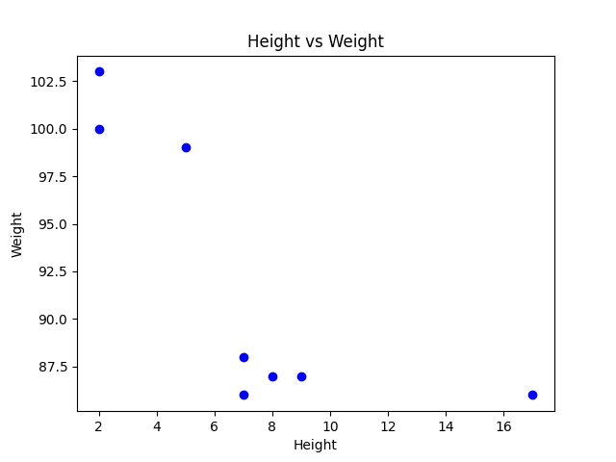
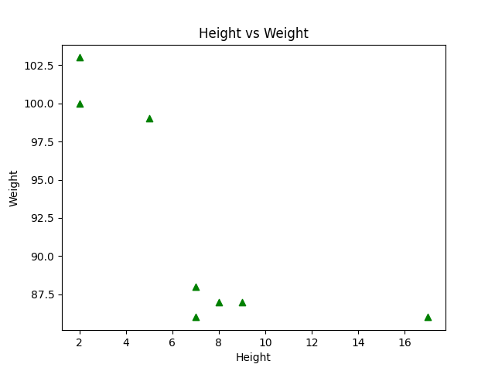
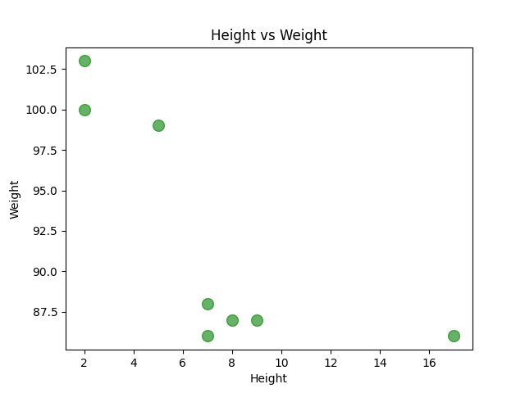
Creating Scatter Plots in Matplotlib
What is a Scatter Plot?
A scatter plot displays values for two variables as points on a 2D plane. It shows relationships, patterns, or correlations.
3. Customization Options
color: e.g., 'red', 'green’
marker: e.g., 'o', '^', 's’
size: using s= parameter for point sizes
alpha: for transparency
Python
plt.scatter(x, y, color='green', s=100, alpha=0.6)
2. Basic Scatter Plot
Python
import matplotlib.pyplot as plt
x = [5, 7, 8, 7, 2, 17, 2, 9]
y = [99, 86, 87, 88, 100, 86, 103, 87]
plt.scatter(x, y, color='blue’)
plt.title("Height vs Weight")
plt.xlabel("Height")
plt.ylabel("Weight")
plt.show()
Use Cases
Visualizing relationships between variables (e.g., age vs income)

Slide 17
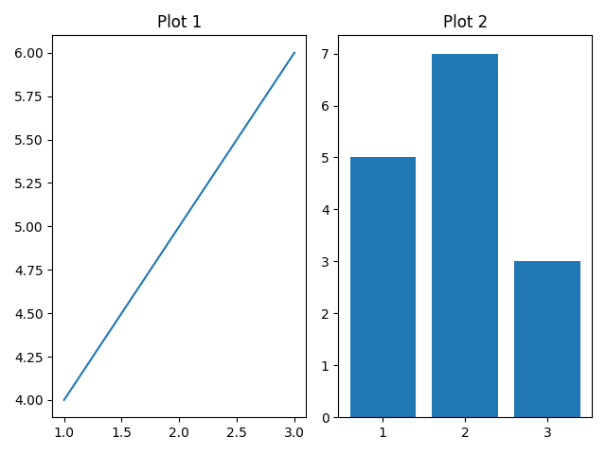
Creating Subplots in Matplotlib
What are Subplots?
Subplots allow multiple plots to be displayed in a single figure.
3. Grid Structure
plt.subplot(rows, columns, index)
Index starts at 1
2. Using plt.subplot()
Python
import matplotlib.pyplot as plt
import matplotlib.pyplot as plt
plt.subplot(1, 2, 1) # 1 row, 2 columns, 1st plot
plt.plot([1, 2, 3], [4, 5, 6])
plt.title("Plot 1")
plt.subplot(1, 2, 2) # 2nd plot
plt.bar([1, 2, 3], [5, 7, 3])
plt.title("Plot 2")
plt.tight_layout() # Adjust spacing
plt.show()
Use Cases
Compare multiple visualizations side by side

Slide 18
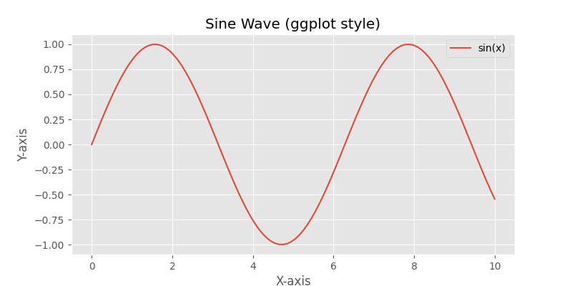
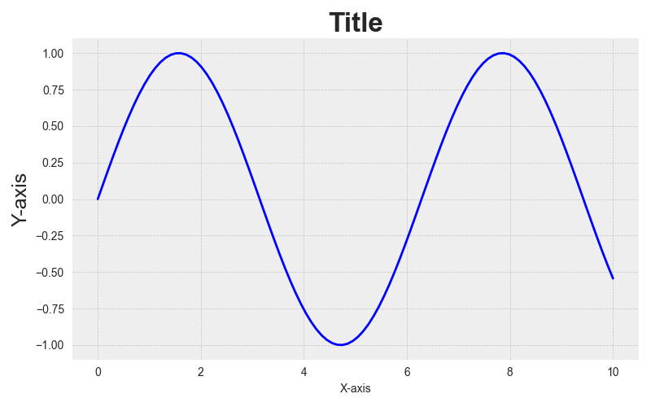
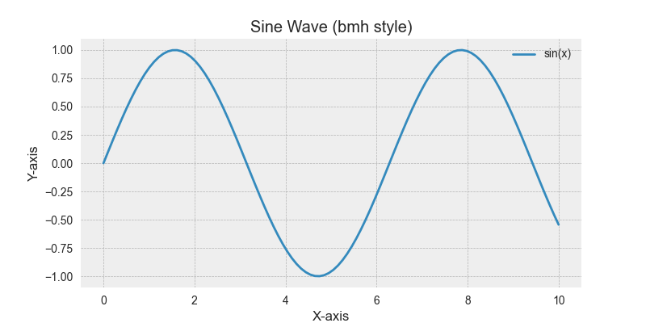
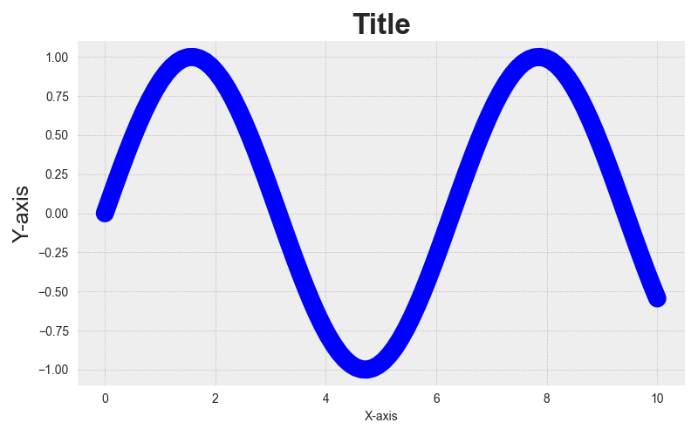
Plot Styling & Themes in Matplotlib
Built-in Styles
Apply a pre-defined style to your plots:
Python
plt.style.use('ggplot’)
Popular styles:-
'ggplot’
'seaborn’
'bmh’
'dark_background’
'fivethirtyeight'
3. Line and Marker Customization
Python
plt.plot(x,
y,
color='purple’,
linewidth=2,
marker='o’,
markersize=8)
2. Customize Fonts & Sizes
Python
plt.title("Title", fontsize=14, fontweight='bold’)
plt.xlabel("X-axis", fontsize=12)
plt.ylabel("Y-axis", fontsize=12)
Use Case
Enhance readability, match publication or brand styles.

Slide 19
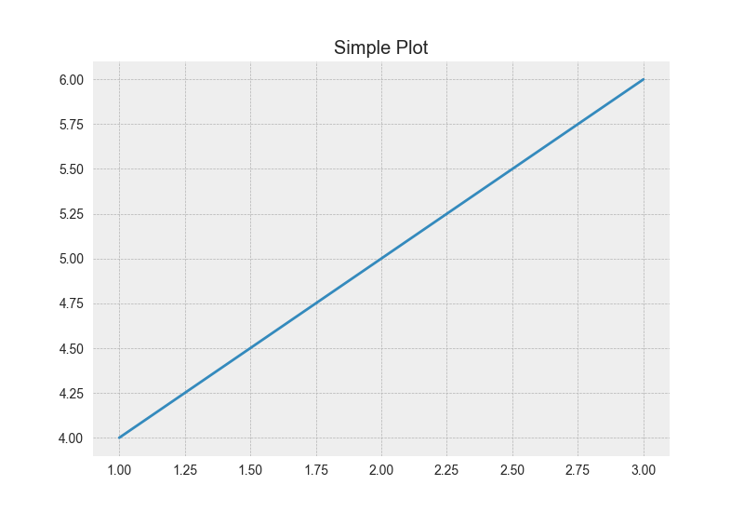
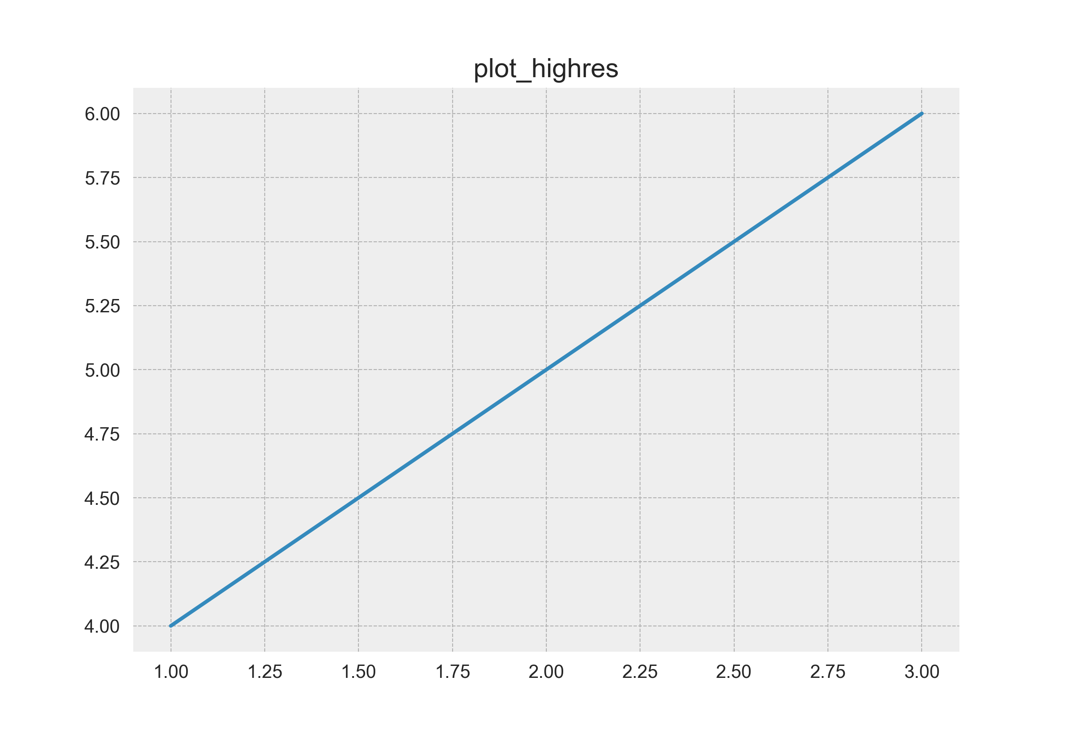
Saving Plots to Files in Matplotlib---
Save a Plot as an Image File
Python
plt.plot([1, 2, 3], [4, 5, 6])
plt.title("Simple Plot")
plt.savefig("plot.png") # Save as PNG
2. Supported File Formats
.png – Most common
.jpg, .jpeg – Compressed image
.pdf – For high-quality printing
.svg – Scalable vector graphics
3. Set Resolution (DPI)
Python
plt.savefig("plot_highres.png", dpi=300)
4. Save Without Displaying
Call plt.savefig() before plt.show()
Once plt.show() is used, the plot is cleared
Use Case
Include plots in reports, articles, or websites

Slide 20
Matplotlib Chart Comparison
Plot Type | Function | Use Case | Example Function
Line Plot | plot() | Trends over continuous data (e.g., time series) | plt.plot(x, y)
Scatter Plot | scatter() | Relationship between two variables | plt.scatter(x, y)
Bar Chart | bar() | Compare categories using rectangular bars | plt.bar(categories, values)
Pie Chart | pie() | Show proportion of categories as slices of a pie | plt.pie(sizes, labels=...)
Histogram | hist() | Frequency distribution of continuous data | plt.hist(data, bins=...)

Slide 21

Q & A
Instructor : Fawad Bahadur

Slide 22
THANK YOU
Instructor : Fawad Bahadur

